Slide 1

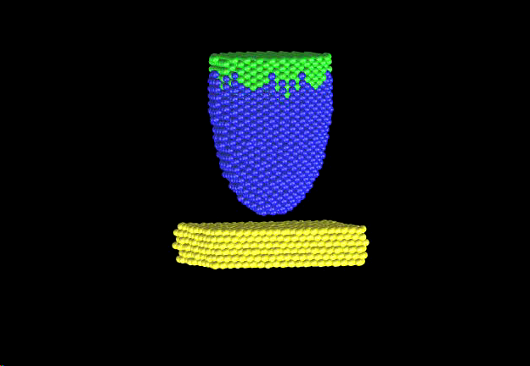
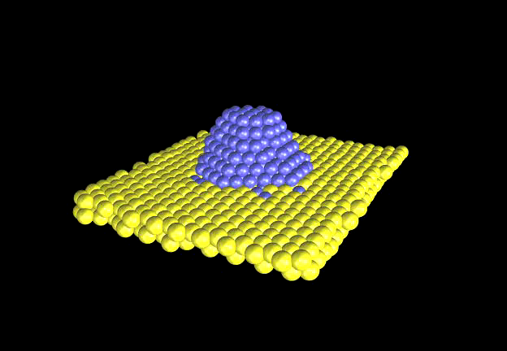
Introduction to random variables
E.P.M. Leiva
Departamento de Química Teórica y Computacional
Facultad de Ciencias Químicas
Universidad Nacional de Córdoba, Argentina

Slide 2
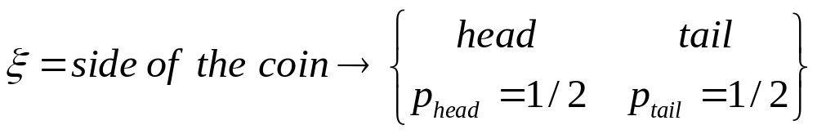
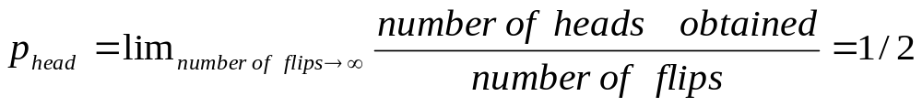
Random variable : it is a variable that may take a given value of a set, but we do not know in advance which value it will take in a concrete case.
Example: flipping a coin
A random variable is defined in terms of the values it may take and the related probabilities

Slide 3
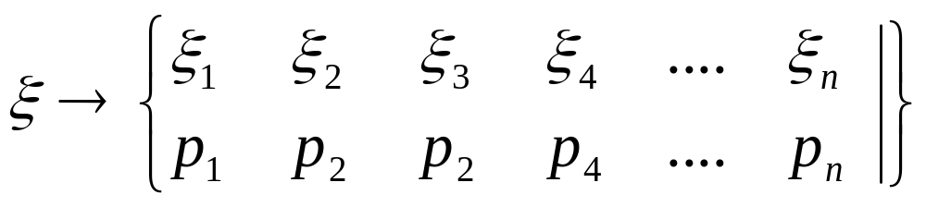
Random variable : it is a variable that may take a given value of a set, but we do not know in advance which value it will take in a concrete case.
Example: flipping a coin
A random variable is defined in terms of the values it may take and the related probabilities
GENERALIZATION (discrete case):
distribution

Slide 4
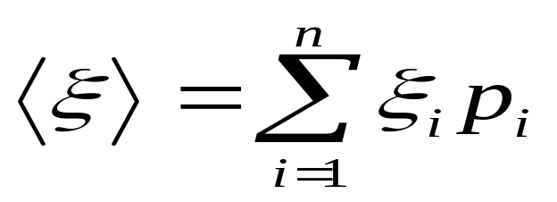
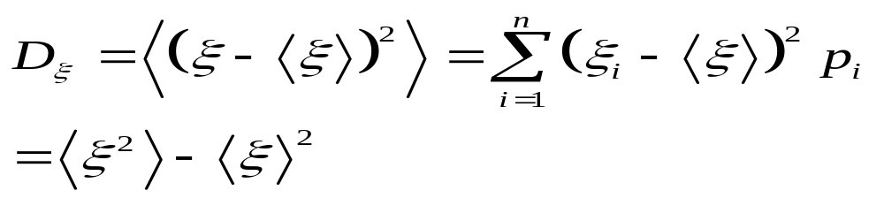

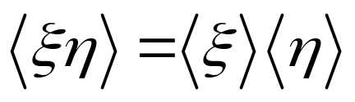

expectation value of ξ
variance value of ξ
For two independent random variables

Slide 5
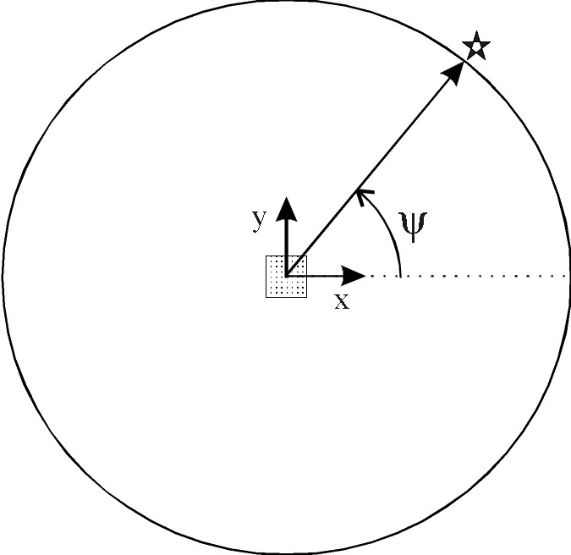
continuous random variables
Scheme of a small piece of radioactive material emitting α particles at the origin of the coordinates. The impact of the particles is measured on a circular screen surrounding the source of α particles. The direction of the particle emitted is characterized by the angle ψ.

Slide 6
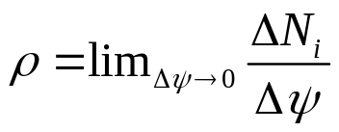


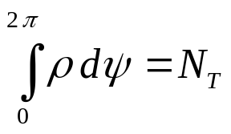
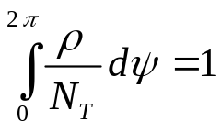
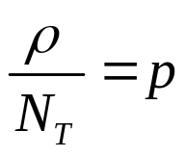
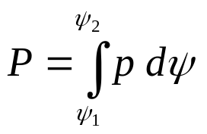

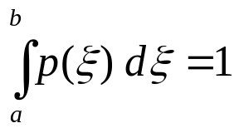
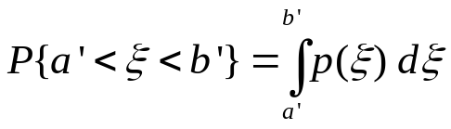
density of impacts
Probability density
Probability P of finding a particle emitted in the interval
Analogously, any continuous random variable ξ is defined if:
the interval [a,b] is given that contains all the possible values of ξ
the density of probability p is given.
Normalization
Probability

Slide 7
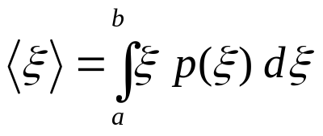
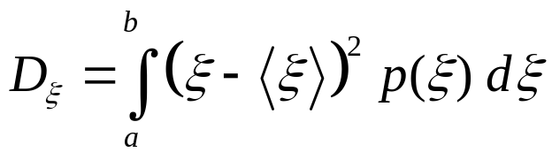


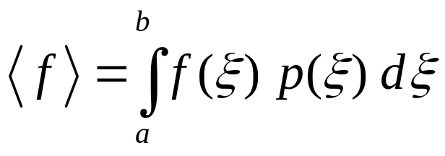
expectation value
variance
If a function of is given, say , its expectation value is given by:
Example from daily life:
Random Variable: Coordinates of our molecular system
R (3N-D vector)
Function of R: System energy U(R)

Slide 8
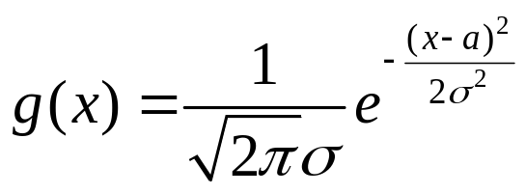
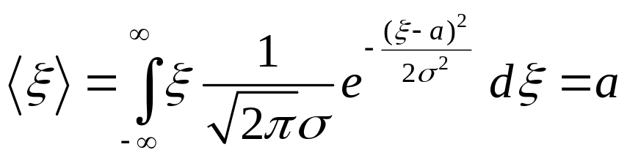
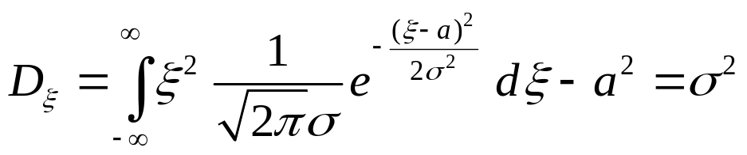
A very famous distribution is the gaussian or normal distribution
expectation value
variance
3 σ rule

Slide 9
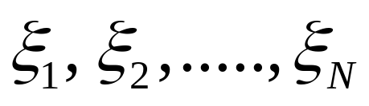
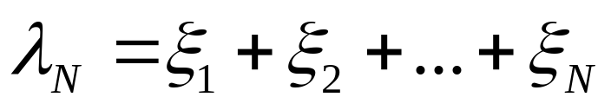
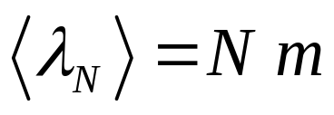
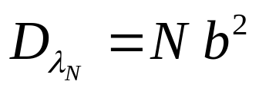

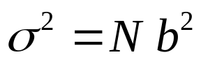
Let us consider N independent random variables
same average value m and the same variance b²
Sum
It can be shown that
Let us now consider a normal random variable χ_{N} that presents

Slide 10
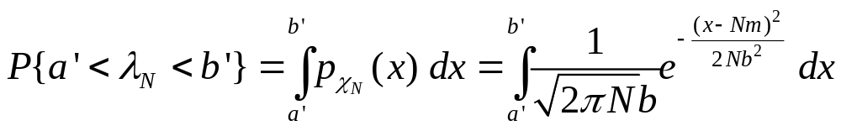
The central limit theorem states that for large N the following is valid:
In other words, under some conditions, the addition of independent random variables behave as a gaussian distribution.
Q:Why is this useful for us?
A: for estimating errors

Slide 11
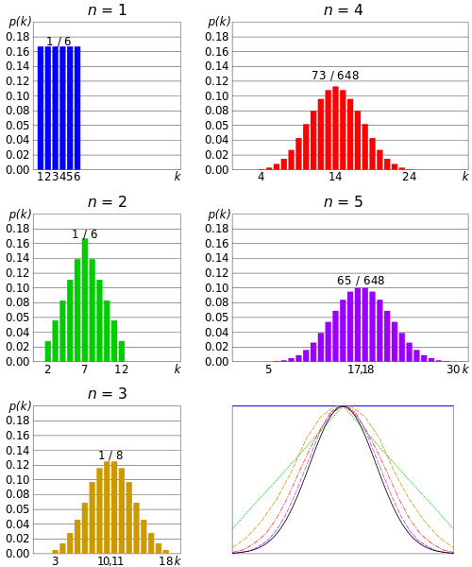





Illustration of central limit theorem: dice throw

Slide 12
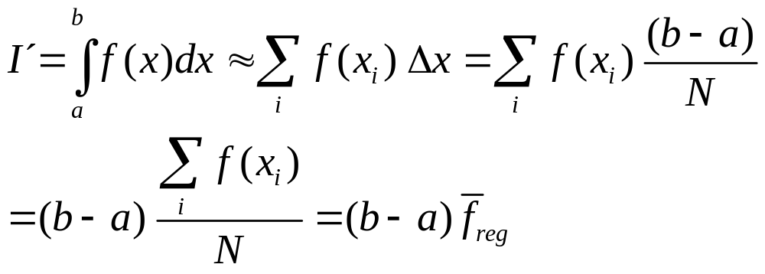
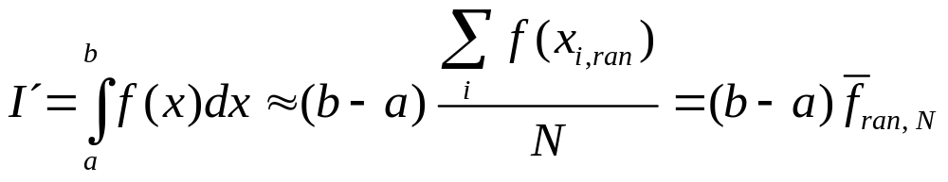
Numeric calculation of the integral
Where “reg” denote a regular spacing of the x_{i}
We could have chosen a uniform random choice of the x_{i}=
Where “ran, N” denote the estimation with uniformlydist. x_{i}

Slide 13
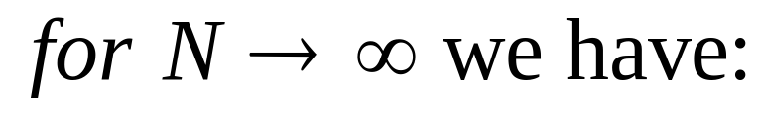
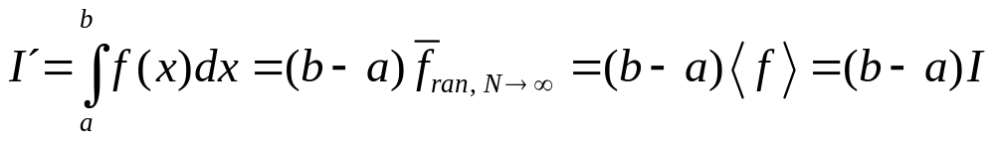
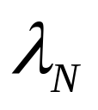

m
And the estimation was:
Let us denote the variance of f with b

Slide 14
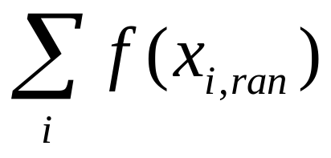
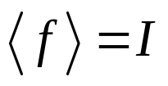
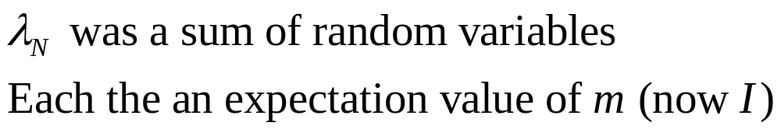
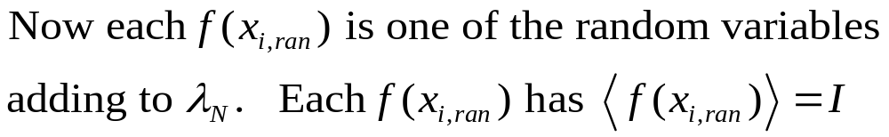
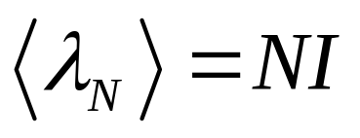
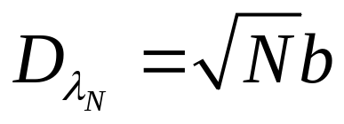
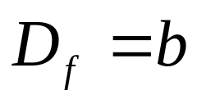
Remember the 3 σ rule for a gaussian random variable
Make the association:
m

Slide 15
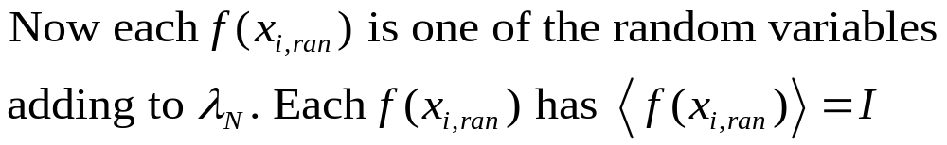
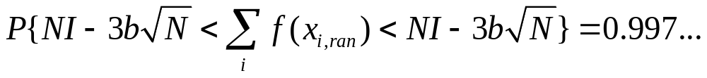
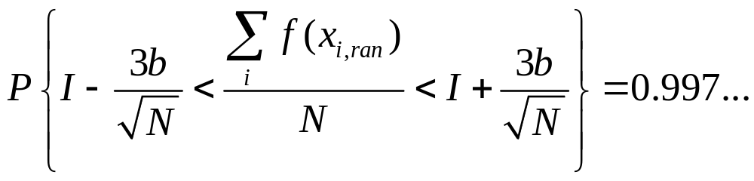

Slide 16
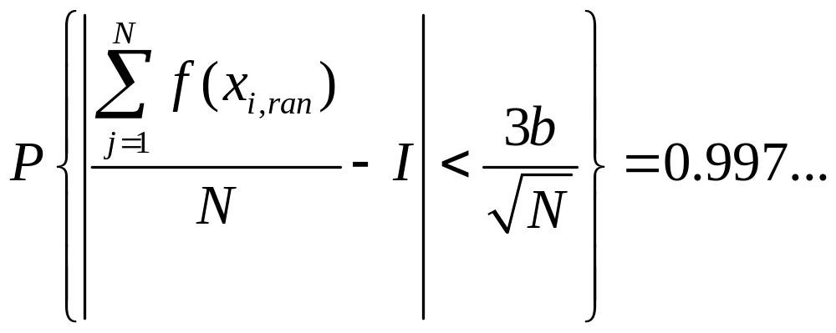

Slide 17
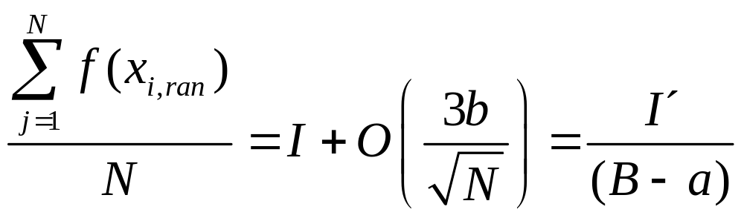

Slide 18
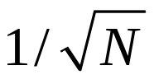
Our MC estimation approaches the correct value with a rate of
This is &$# slow!!

Slide 19
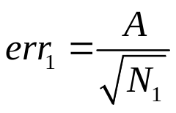
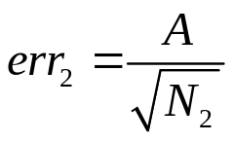
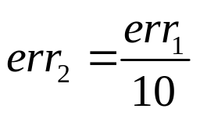

Our MC estimation approaches the correct value with a rate of
.
This is &$# slow!!
If fact, let us consider two errors,
and
so that
this yields

Slide 20





Compare for example with some simple numeric integration
Method (trapezium method):
and
so that
this yields
In this method, which is no particularly good, to improve one order of magnitude the accuracy, we hat to multiply N by

Slide 21


However,let us see what happens in higher dimensions.
In 2-D, to increase the precision in a factor of 10, in the case of the trapezium method, the number of points should be increased by
Or more generally in d-D, to increase the precision, in the case of the trapezium method, the number of points should be increased by a factor
So for d=4 the order of the convergence is a slow as MC, and later the situation worsens very rapidly.

Slide 22
The MC estimation improves its accuracy with in any dimension!!

Slide 23


We have seen that the convergence is slow. Can we do anything to improve MC accuracy?
In function like this, a uniform distribution of sampling points would we a waste of time,since the relevant parts of the function are concentrated in a small region

Slide 24

We can multply and divide by a weight function:
Where the points x_{i,ran} are now generated with the distribution w.
Thus, if the function w follows the shape of f, the ratio f/ w will be close to 1 and the sampling will be more efficient.
The previous methodology is denominated importance sampling

